Slide 1

Bell Work:
Factor:
$$x^{2}−9x+18$$
$${2x}^{2}−18$$

Slide 2
From Last Time…
New Material:
Page 221 #1–8, 15–25(odd), 33, 35,
47, 49, 51, 61, 63, 99

Slide 3
ALGEBRA 3
Day 36

Slide 4
4.4 Factoring Quadratic Expressions Objective: To factor a quadratic equation into the product of two binomials

Slide 5
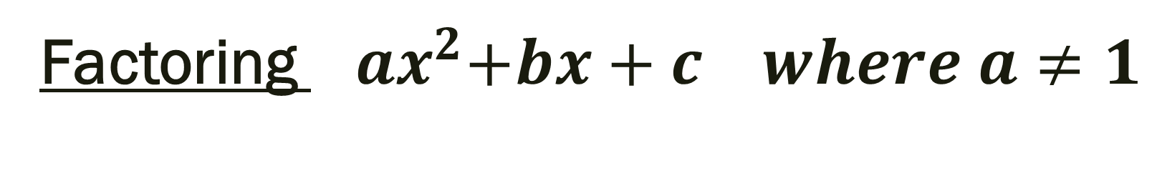
Factoring ${ ax}^{2}+bx+c where a≠1$
ax² + bx + c = (kx + m)(lx + n)= k*lx² + (k*n + l*m)x + m*n
a = k*l b = k*n + l*m c = m*n
Steps:
1)Find and list the factors of a and c
2) Set up the proportion:
3) Cross multiply to get numbers that add and
give you b. (Guess and Check)

Slide 6

Factor:
1.) $4x^{2} – 25$
2.) 2x² + x – 3
3.) 3x² – 17x + 10
4.) 8z² + 18z + 9
5.) 6x² – 9x + 5
6.) 11m² + 14m – 16
7.) $5x^{2} – 20$

Slide 7
4.5 Quadratic Functions
Objective: Solve Quadratic Equations

Slide 8
Zero of the Function: whenever the graph of a function, f(x), intersects the x-axis, in other words when f(x)=0. (A solution)
Zero-Product Property: if ab=0 then a=0 or b=0
We use this property to solve quadratic equations after factoring.

Slide 9

Example 1 Solve by Factoring :
$$x^{2}+5x+6=0$$

Slide 10
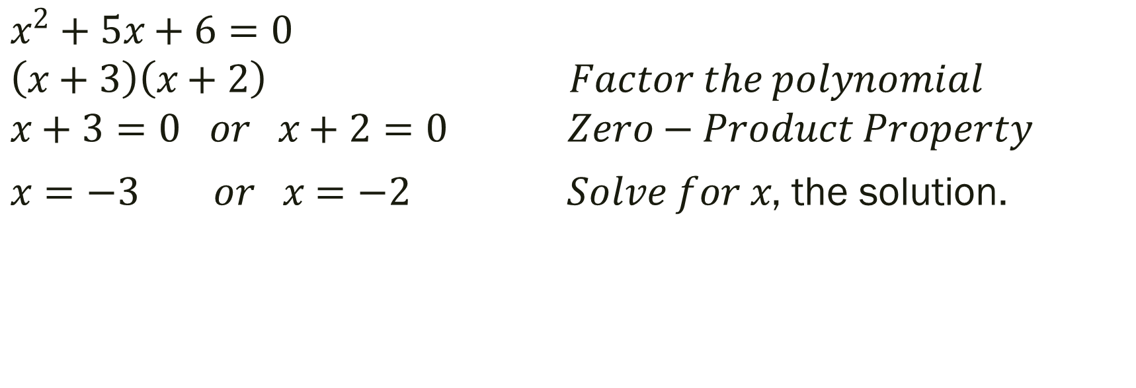
Example 1: Solution
$$x^{2}+5x+6=0$$
$$\left(x+3\right)\left(x+2\right) Factor the polynomial$$
$$x+3=0 or x+2=0 Zero−Product Property$$
$x=−3 or x=−2 Solve for x$, the solution.

Slide 11

Example 2: Solve by Graphing
$$x^{2}−3x=10$$

Slide 12
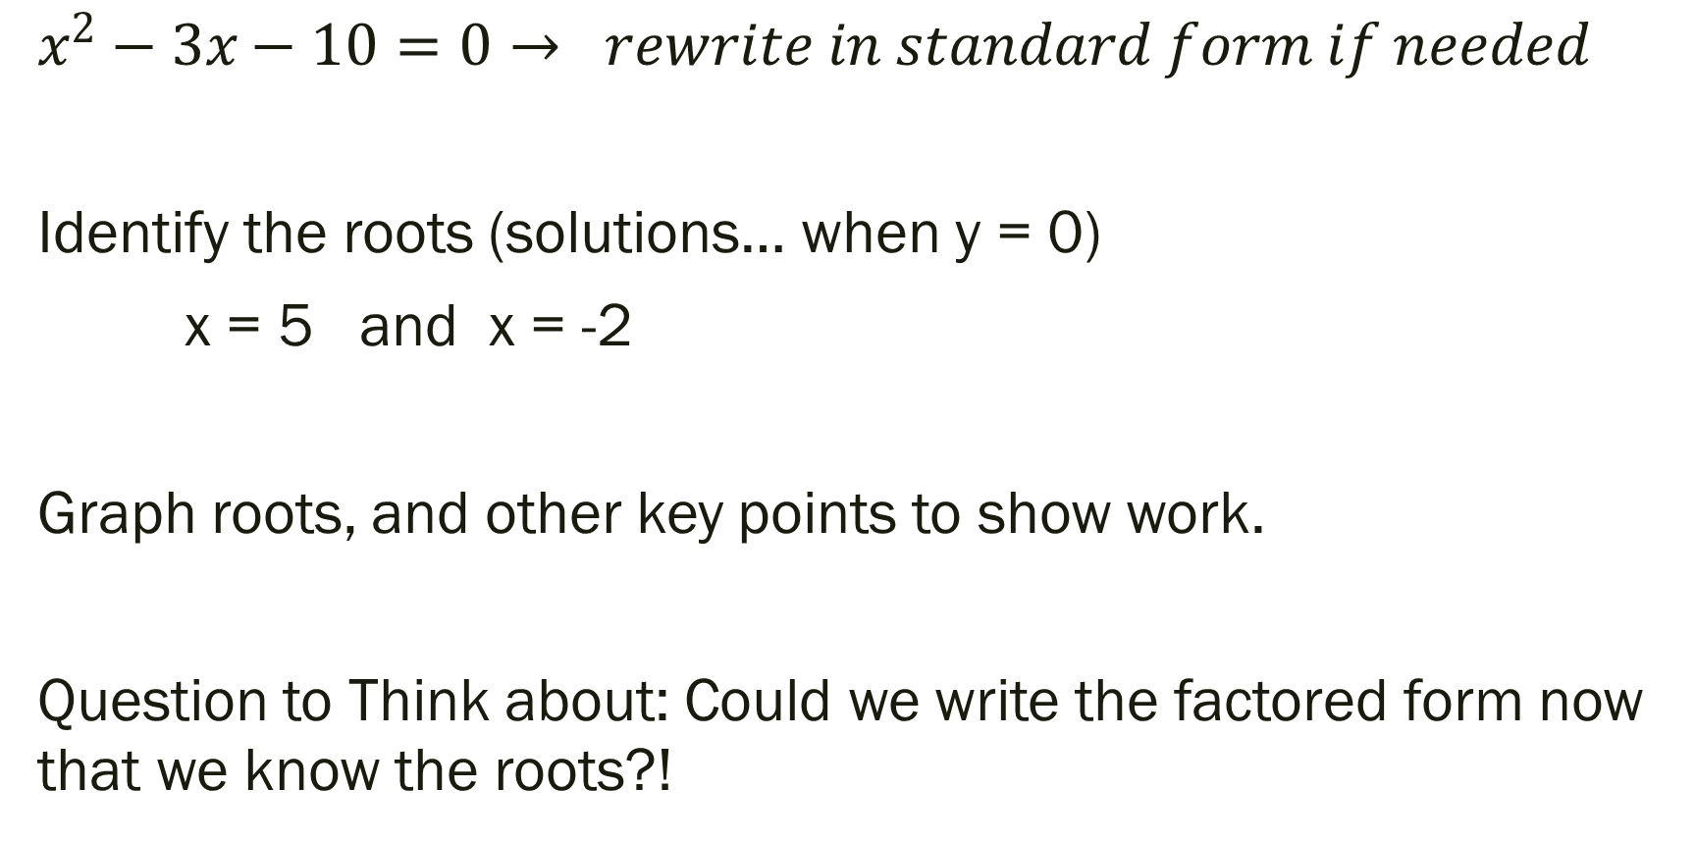
Example 2: Solution
$$x^{2}−3x−10=0→ rewrite in standard form if needed$$
Identify the roots (solutions… when y = 0)
x = 5 and x = -2
Graph roots, and other key points to show work.
Question to Think about: Could we write the factored form now that we know the roots?!

Slide 13

Example 3: Solve by Graphing.
$${3x}^{2}−5x−4=0$$

Slide 14

Example 3: Solution.
$${3x}^{2}−5x−4=0$$
Zeros: $x=−0.59 and x=2.26$

Slide 15

More Examples: Solve for x.
$x^{2}−7x=−10$
$${2x}^{2}=x+3$$
$$x^{2}−16=0$$
$$x^{2}−x−12=0$$

Slide 16
For Next Time
New Material:
Page 229 #1-6, 9-17 (odd), 31, 44
Mixed Review:
Page 231 # 67(use a matrix), 73

